Slide 1
FLASH CARD: A Memorization Technique
Submitted by : V. V. Divya

Slide 2
Table of content
Abstract
Software Description
Code Segment
Sample Screenshots
Conclusion
Bibliography

Slide 3
Abstract
FLASH CARD: A Memorization Technique aims to develop a memorization technique.
Flash cards are widely used to memorize new topics.
A question or keyword or title is written in one side of card and its answer or description will be on the other side of the card.
Then we need to go through the card repeatedly and test oneself to check if we learned the concept.

Slide 4
Objectives
1.Creating Flashcard.
2. Adding Flashcard title
3. Adding description for the flashcard
4.Deleting Flashcard.
5.Updating Flashcard.

Slide 5
Software Requirement
Python
Python is a widely used programming language.
It is easy to use and uses very simple syntax that adds to its popularity.
Python efficiently handles high level data with its library developed for specific purposes.
The Python interpreter and the extensive standard library are freely available in source or binary form for all major platforms from the Python Website, https://www.python.org/.

Slide 6
Software Requirement
Vscode
Visual Studio Code is one of most popular code editors.
It is a lightweight but powerful editor which runs desktop and is available for Windows, macOS and Linux.
It comes with built-in support many popular programming languages

Slide 7
Software Requirement
Django:
Django is a high-level Python web framework designed to help developers build complex web applications rapidly and securely.
The primary source for documentation, tutorial and information for Django is https://www.djangoproject.com/

Slide 8
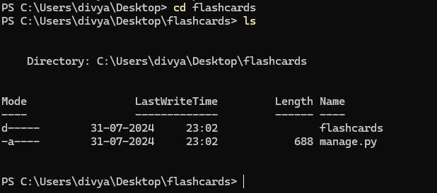
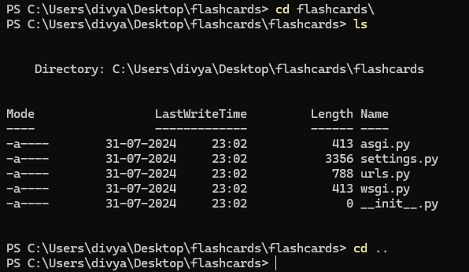
Starting the Project
1.To start the project, use this command
python -m django startproject projectname
python -m django startproject flashcard
cd flashcards

Slide 9
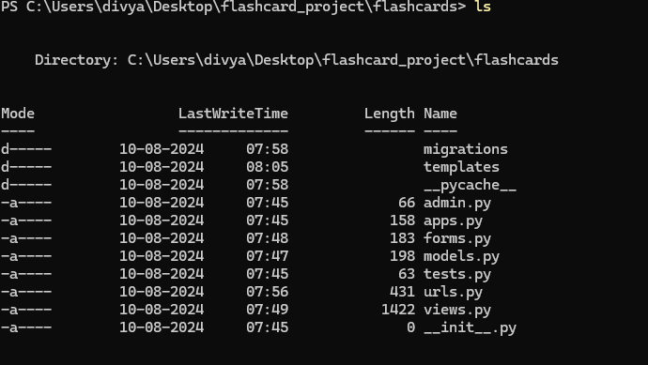
Stating the application
2. To start the app use this command
python manage.py startapp application name
python manage.py startapp flashcards

Slide 10
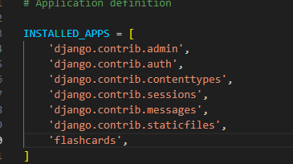
.
3. Add this app(flashcards) to the ‘settings.py’

Slide 11
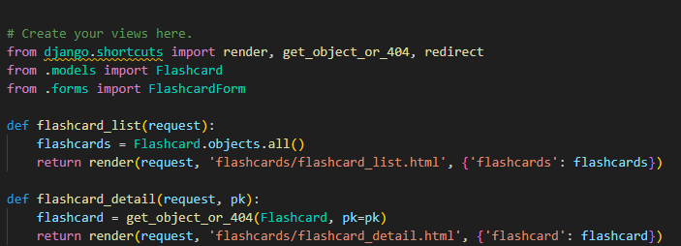
Adding other necessary files.
Views.py
Handles user request and response
Defines functions called views that determine how application responds to different URL patterns
This views created need to be mapped to urls in tha application
Notes:
render is a built-in function in Django that simplifies the process of creating Http response

Slide 12
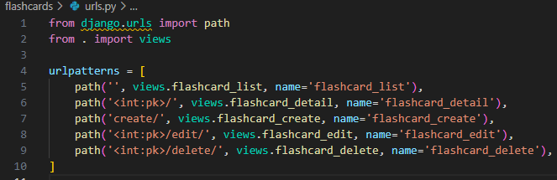
Adding other necessary files
urls.py
(C:\Users\divya\Desktop\flashcard_project\flashcards\urls.py)
map the views to a url, to handle the request.
This url need to be imported to main url inside the project folder(flashcard_project)

Slide 13
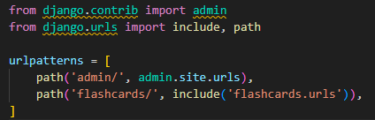
Adding other necessary files
urls.py
C:\Users\divya\Desktop\flashcard_project\flashcard_project\urls.py
Any url that starts with flashcards will be rafted to flashcards application.

Slide 14
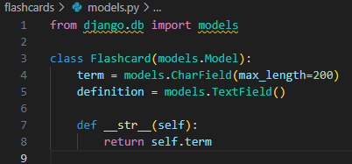
Adding other necessary files
models.py
Defines the data structure of the application.
Manages data in the application’database.
Defines two fields ; term and definition are defined.
Notes:
This code defines a Django model named Flashcard, which is used to represent flashcards in a database. In Django, a model is a Python class that corresponds to a database table. Here's a breakdown of what each part of the code does:
Class Definition (Flashcard):
The class Flashcard inherits from models.Model, meaning it represents a database model.
Each instance of this class corresponds to a single record (row) in the database table.
Fields:
term = models.CharField(max_length=200): This defines a field named term that stores a string of text (characters). It is a CharField, which is typically used for short text. The max_length=200 argument specifies that the maximum length of the text is 200 characters.
definition = models.TextField(): This defines a field named definition that stores a larger amount of text. It is a TextField, which is used for longer text entries with no predefined length limit.
String Representation (__str__):
The __str__ method is a special method in Python that returns a string representation of an object. In this case, it returns the value of the term field. When you print an instance of the Flashcard class or see it in the Django admin interface, it will display the value of the term.
Database Table:
Django will create a corresponding database table for this model, typically named appname_flashcard where appname is the name of the Django application. Each field (e.g., term, definition) becomes a column in that table.
In this code defines a Django model Flashcard with two fields, term and definition, to store the term and its corresponding definition.

Slide 15
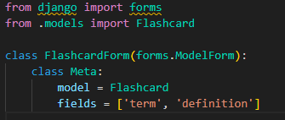
Adding other necessary files
forms.py
(C:\Users\divya\Desktop\flashcard_project\flashcards\templates\flashcards)
Defines a Django form(forms.py) that is tied to the model.
Allows users to interact with the application through the web browser
Notes:
defines a Django form (FlashcardForm) that is tied to the Flashcard model. It includes fields for term and definition, allowing users to create or update flashcards via a web form.

Slide 16
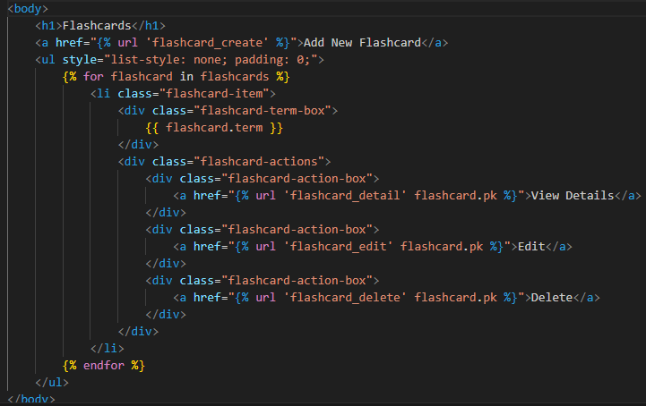
Creating GUI
flashcard_list.html
flashcard_project\flashcards\templates\flashcards\flashcard_list.html
Displaying a list of flashcards, with options to view, edit, or delete each flashcard.

Slide 17
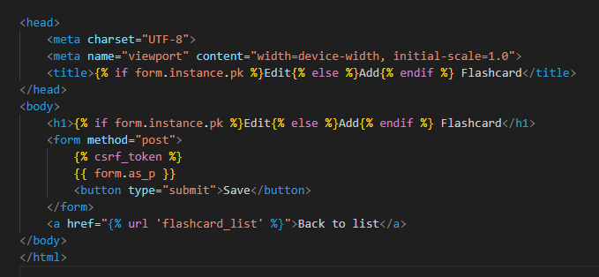
Creating GUI
flashcard_form.html
flashcard_project\flashcards\templates\flashcards\flashcard_form.html
Adding a new flashcard and editing an existing one.

Slide 18
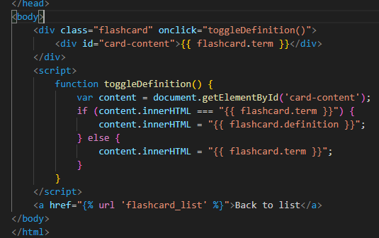
Creating GUI
flashcard_detail.html
Path:flashcard_project\flashcards\templates\flashcards\flashcard_detail.html
Creates an interactive flashcard that shows a term by default. When clicked, the flashcard toggles to display the definition and vice versa

Slide 19
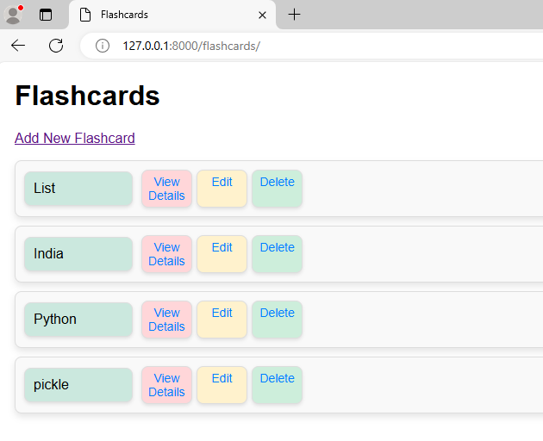
Sample Screenshots

Slide 20
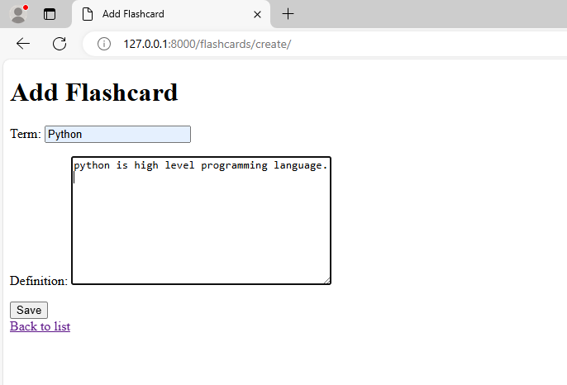
Sample screenshots

Slide 21
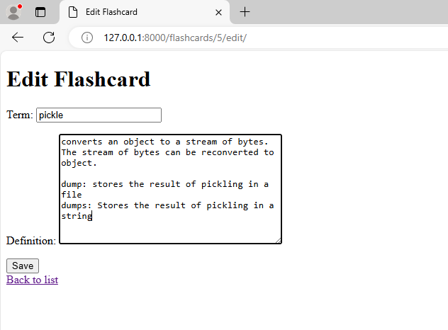
Sample Sceens

Slide 22
Conclusion and Future Scope
The project is completed within the stipulated time. All the functionalities are tested and found to be working properly.
Future enhancement
Paragraph summarization, such that system itself generate flashcard based on the data provided.
Grouping flashcard manually and automatically based on the category or interest or relevance or relationship or topics.
Categorize flashcard based on if the content is learned or not.

Slide 23
Bibliography
1. https://docs.python.org/3.14/library/index.html
2. https://www.djangoproject.com/
3. https://www.geeksforgeeks.org/build-a-flashcards-using-django/#
4. https://www.w3schools.com/css/

